Slide 1
Thyroid Class Prediction

Slide 2
Major Learning from the Project

Slide 3
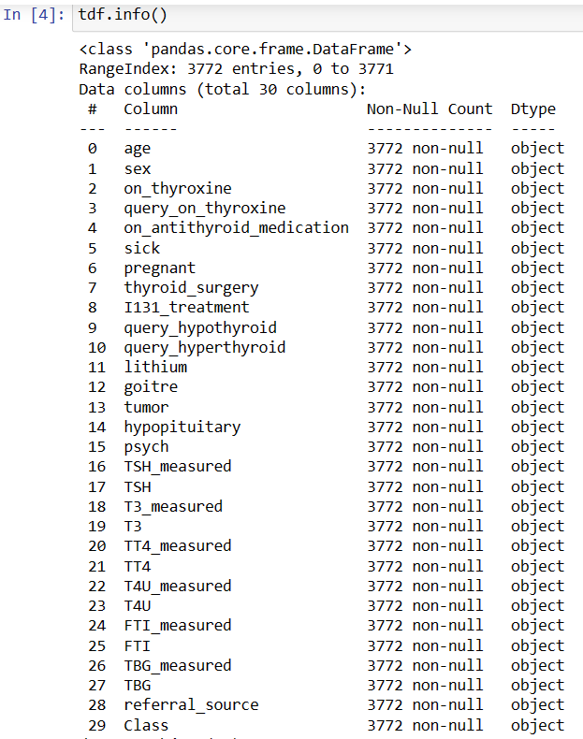
Data Frame

Slide 4
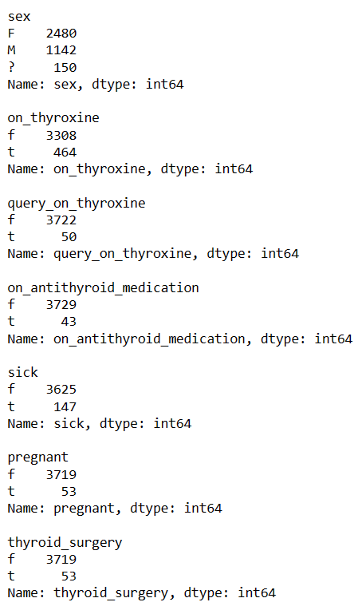
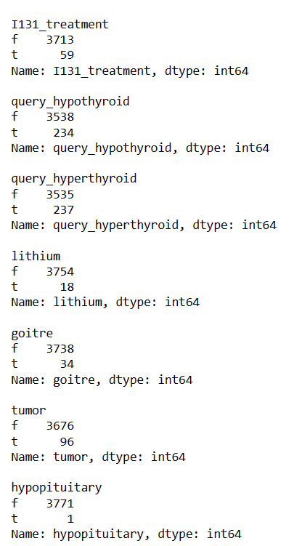
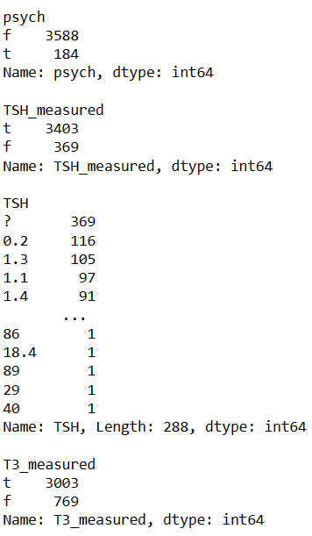

Slide 5
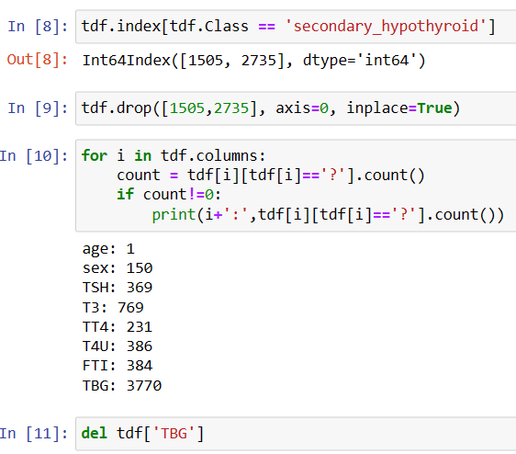

Slide 6
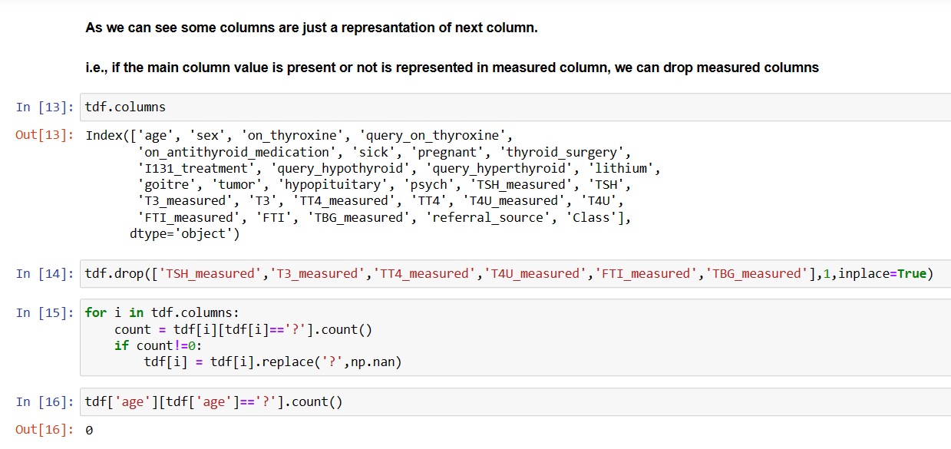

Slide 7
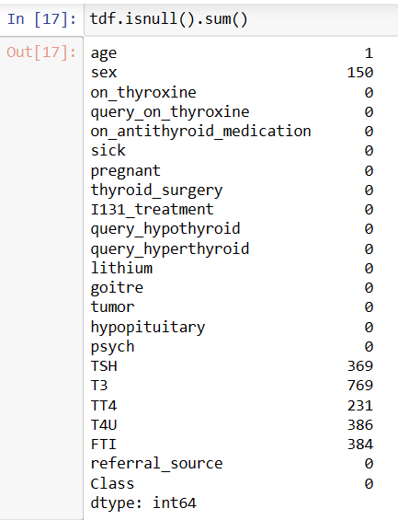
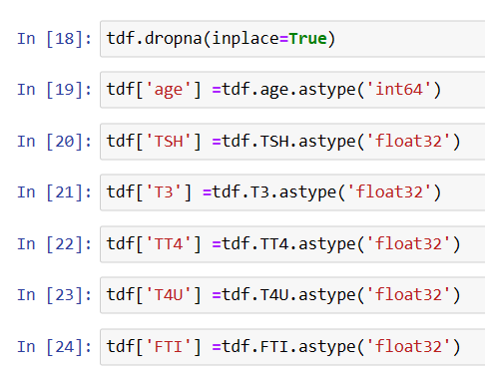

Slide 8
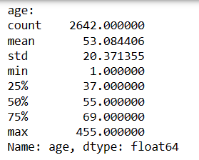
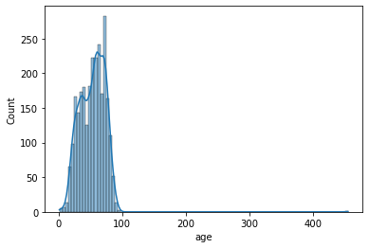
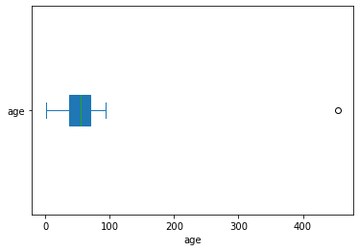
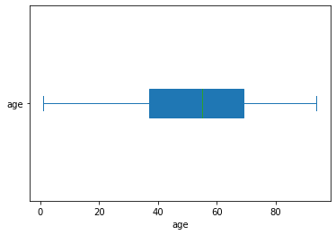

Slide 9
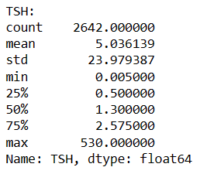
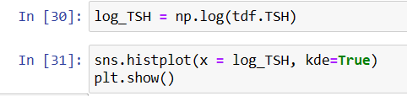
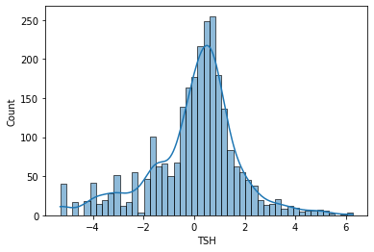
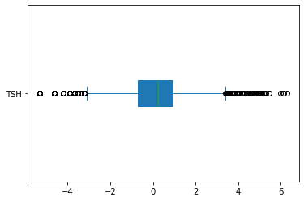

Slide 10
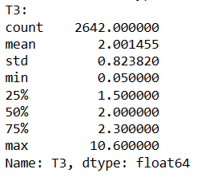
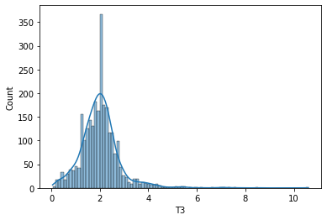
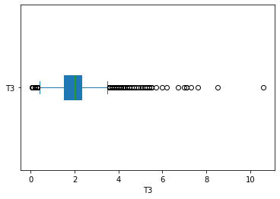

Slide 11
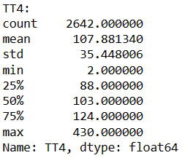
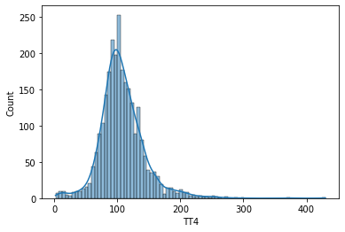
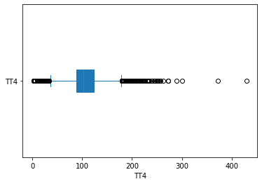

Slide 12
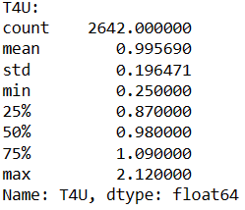
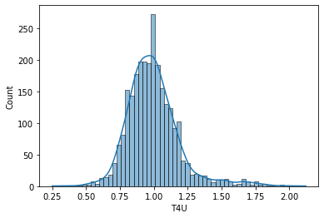
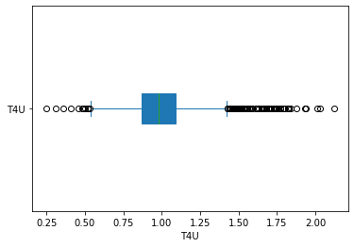

Slide 13
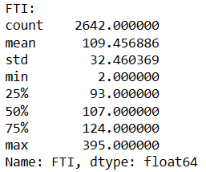
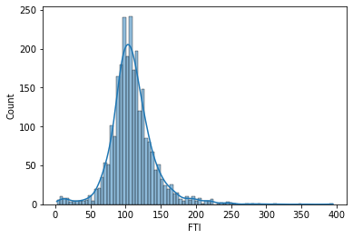
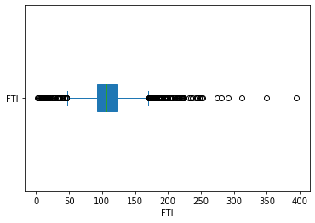

Slide 14
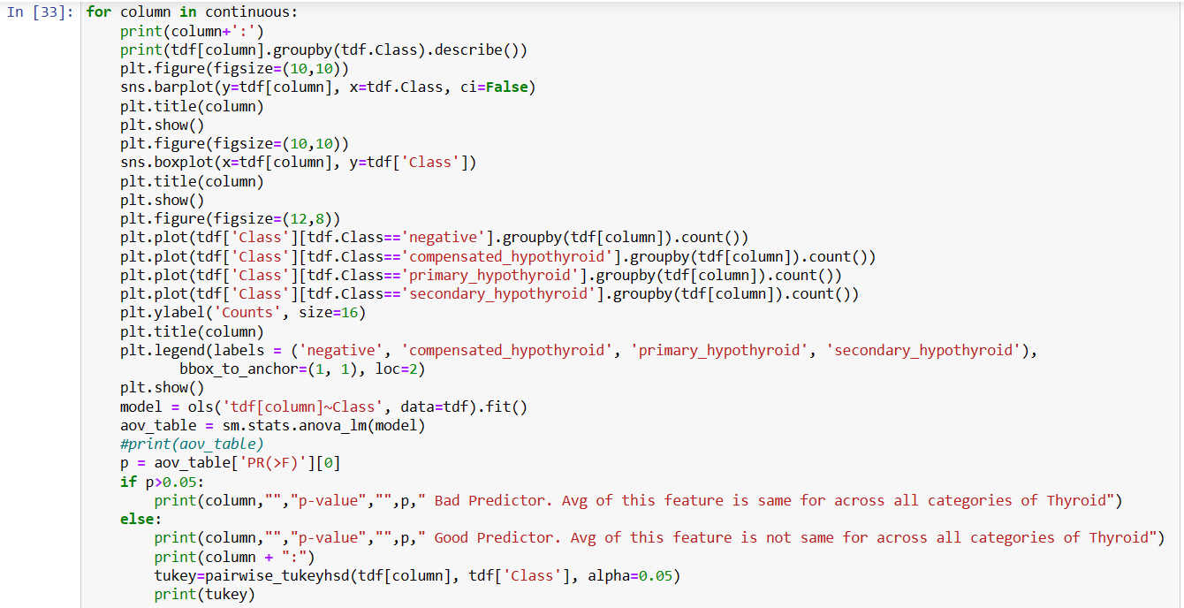

Slide 15
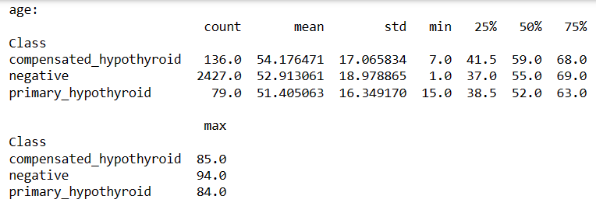
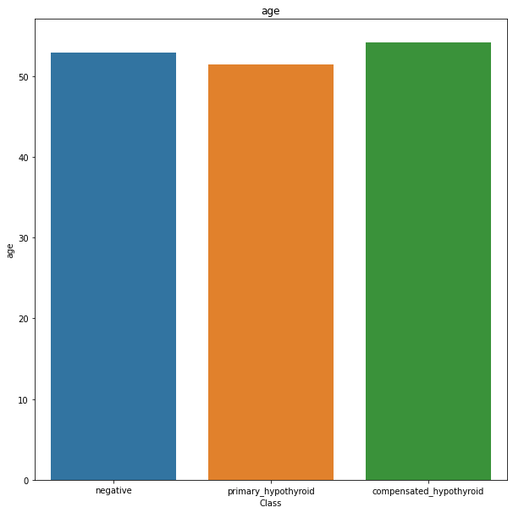
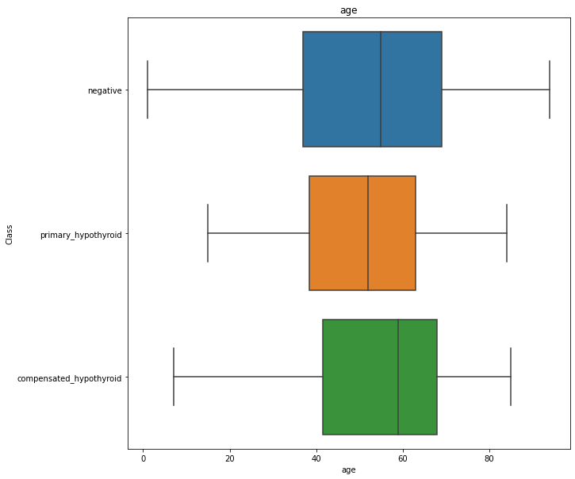

Slide 16
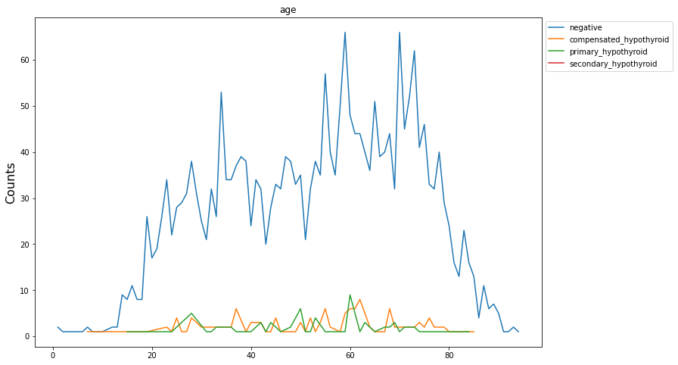
age p-value 0.5718512659994945 Bad Predictor. Avg of this feature is same for across all categories of Thyroid

Slide 17
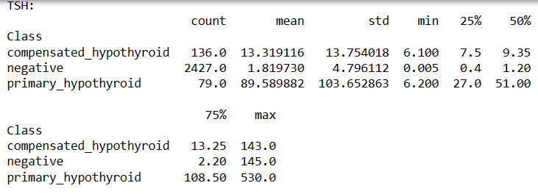
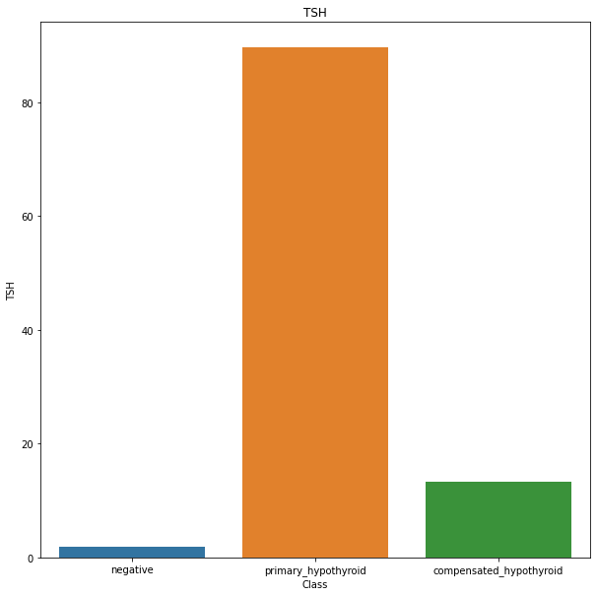
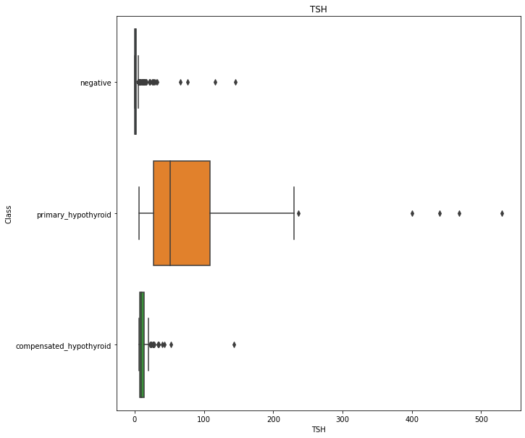

Slide 18
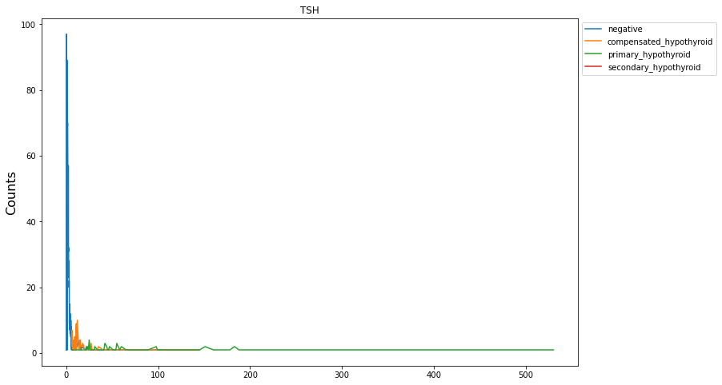

Slide 19
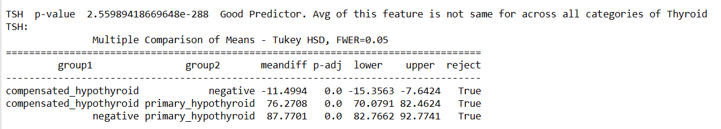

Slide 20
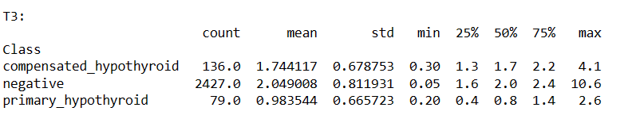
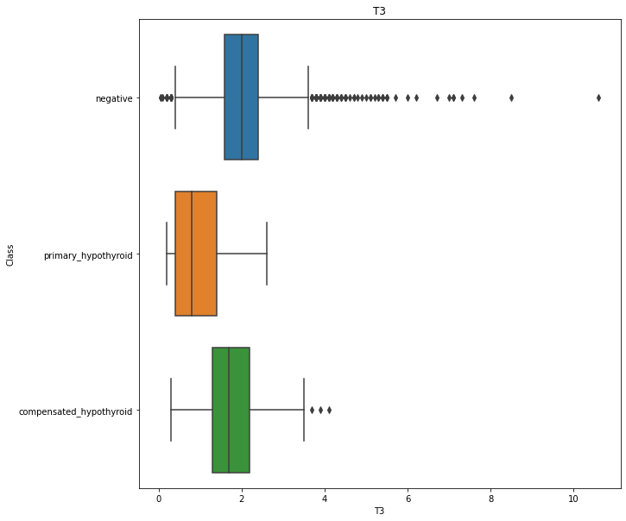
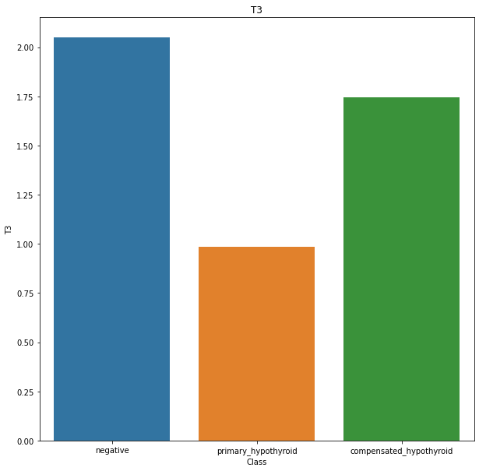

Slide 21
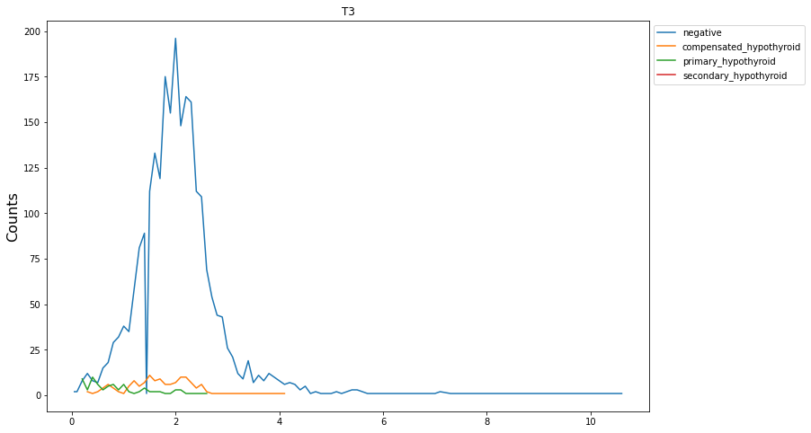

Slide 22
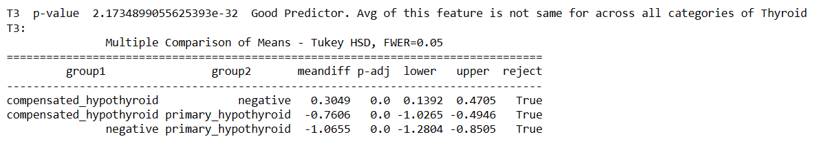

Slide 23
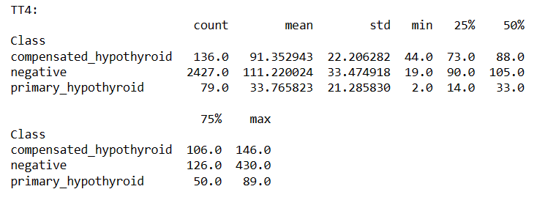
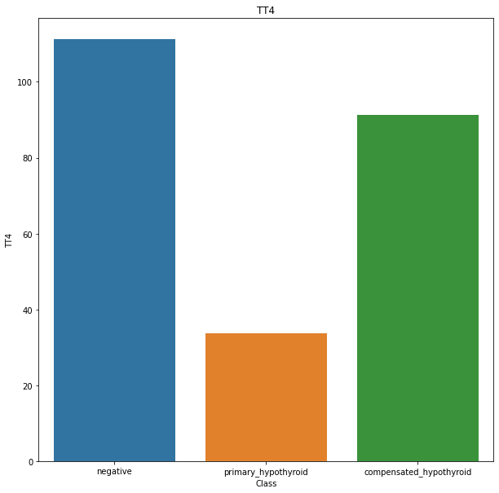
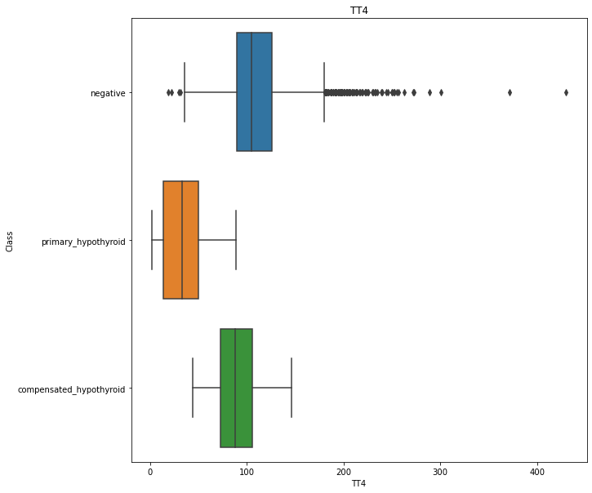

Slide 24
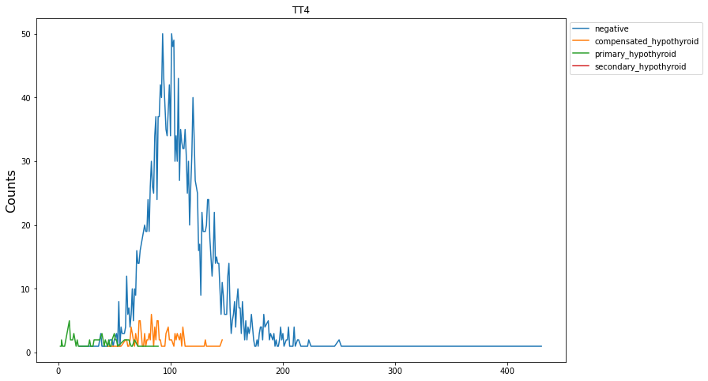

Slide 25
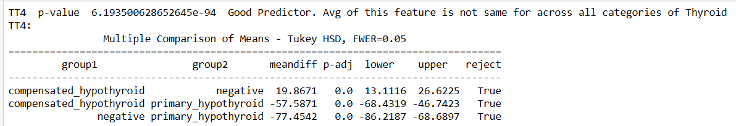

Slide 26
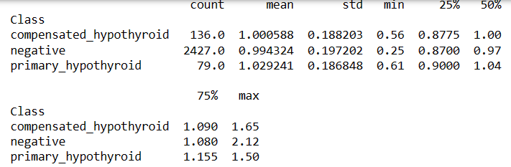
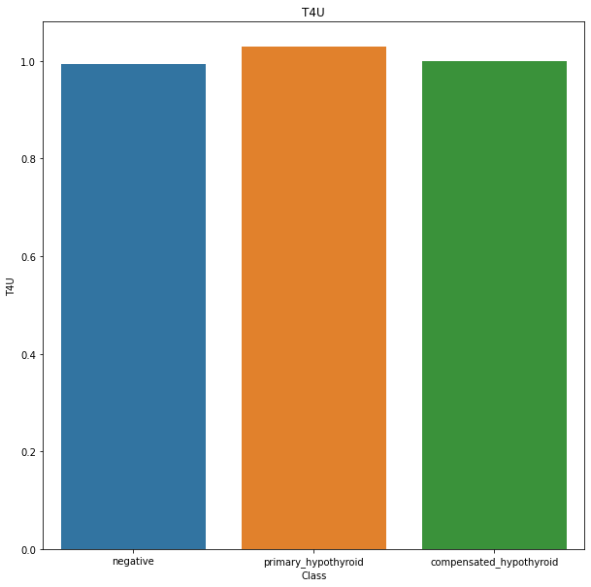


Slide 27

T4U p-value 0.28580678244408736 Bad Predictor. Avg of this feature is same for across all categories of Thyroid

Slide 28




Slide 29


Slide 30


Slide 31
# Average age of people getting tested for thyroid is between 50-60. We see extreme outliers for negative class which is illogical. Overall
# Overall we can see distribution of all class in the similar range. No. people getting tested has negative outcome.
# We see significantly high TSH for primary_hypothyroid, but we see some abnormal high TSH for Primary Hypothyroid
# T3 value is high for primary hypothyroid and negative is high. Most of the people with negative thyroid have score around 2-3
# # Distribution of data on TT4 is from 0 to 200. Primary hypothyroid have 0 to 50 score. Most People with negative thyroid having
# having score around 100. People with compensated hypothyroid is having 70 to 120 with peak around 80. Negative Group and Compensated
# hypothyroid group is having higher TT4 Score
# Distribution follows similar pattern for all the group. Most of the people are having T4U Score around 1, irrespective of the group
# Compensated Hypothyroid and negative thyroid people is having higher FTI score with a peaf around 100. Primary
# Hypothyroid group is having lower FTI score ranging around 0 to 60.

Slide 32

# Query on Hypothyroid, Referral from SVHC, on Throxine and Male are less prone to thyroid.

Slide 33


Slide 34


sex p-value 0.002559000568269117 Good Predictor. There is significant relationship between the variables

Slide 35


on_thyroxine p-value 0.0002845835943214777 Good Predictor. There is significant relationship between the variables

Slide 36


query_on_thyroxine p-value 0.5483101655828677 Bad Predictor. There is no significant relationship between the variables

Slide 37


on_antithyroid_medication p-value 0.5002840489327447 Bad Predictor. There is no significant relationship between the variables

Slide 38


sick p-value 0.06890517188195848 Bad Predictor. There is no significant relationship between the variables

Slide 39


pregnant p-value 0.15807994816373938 Bad Predictor. There is no significant relationship between the variables

Slide 40


thyroid_surgery p-value 0.40347624212861943 Bad Predictor. There is no significant relationship between the variables

Slide 41


I131_treatment p-value 0.32241017442691366 Bad Predictor. There is no significant relationship between the variables

Slide 42


query_hypothyroid p-value 0.00012638856458394162 Good Predictor. There is significant relationship between the variables

Slide 43


query_hyperthyroid p-value 0.44118559432473425 Bad Predictor. There is no significant relationship between the variables

Slide 44


lithium p-value 0.7667392642648186 Bad Predictor. There is no significant relationship between the variables

Slide 45


goitre p-value 0.40957939415646727 Bad Predictor. There is no significant relationship between the variables

Slide 46


tumor p-value 0.9786322594181877 Bad Predictor. There is no significant relationship between the variables

Slide 47


hypopituitary p-value 0.9566572159595668 Bad Predictor. There is no significant relationship between the variables

Slide 48


psych p-value 0.04672545161110959 Good Predictor. There is significant relationship between the variables

Slide 49


referral_source p-value 0.002634460049492708 Good Predictor. There is significant relationship between the variables

Slide 50
# Count of Female taking test is high. We can see there is a significant decrease in call categories of thyroid for male
# People on thyroxine are primarily not having thyroid. This is because mostly it is a regular health check-up
# Very Few people are querying on thyroxine with thryroid. It is a bad predictor
# Very Few people are querying on anti-thyroid medication with thyroid. It is a bad predictor
# Very Few people are sick with thyroid. It is a bad predictor
# Very Few people are pregnant with thyroid. It is a bad predictor
# Very Few people with thyroid surgery are having thyroid. It is a bad predictor
# Very Few people with I131 Treatment are having thyroid. It is a bad predictor
# No.people quering hypothyroid is less, where most of the people are not having thyroid
# Very Few people querying on hyperthyroid are having thyroid. It is a bad predictor
# Very Few people with Lithium are having thyroid. It is a bad predictor
# Very Few people with goitre are having thyroid. It is a bad predictor
# Very Few people with tumor are having thyroid. It is a bad predictor
# Very Few people with hypopituitory are having thyroid. It is a bad predictor
# Very Few people with psych are having thyroid. It is a bad predictor
# Other type of Referral Count is the highest. But no.of Referrral coming from SVHD is least. Among people having thyroid highest
# count is for compensated hypothyroid

Slide 51

# Class is linearly separable

Slide 52


Slide 53


Slide 54


Slide 55


Slide 56



Slide 57


Slide 58


